Slide 1
Server-side Programming
Handling HTTP Methods in Flask

Slide 2
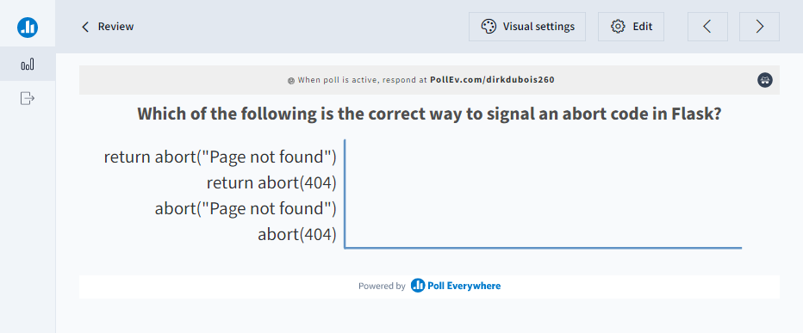
Let’s review

Slide 3
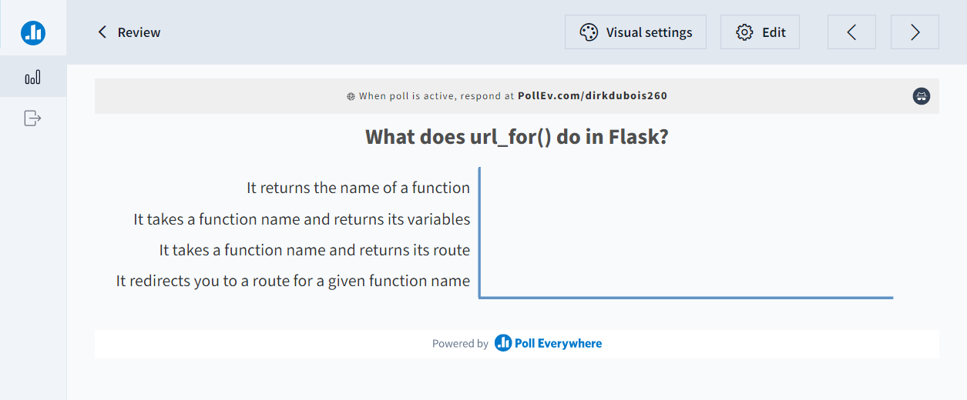
Let’s review

Slide 4
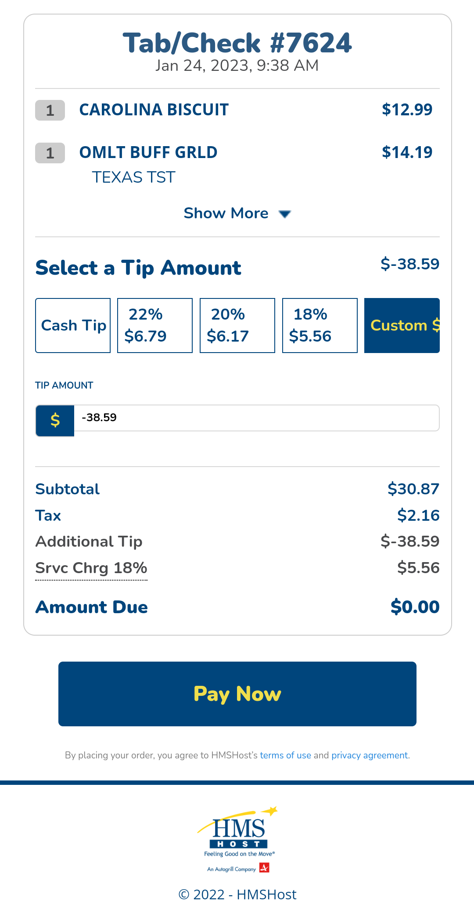
Input validation is key!

Slide 5
Templating in Flask
Creating dynamic HTML content

Slide 6
Templates allow for dynamic HTML content
Flask can deliver static HTML files for a given route
Templating involves defining HTML code that can be filled in dynamically
Depending on the context data in the template can be modified
Templates must be placed in the ‘templates’ directory
@app.route('/')
def index():
return render_template('home.html')
Project
app.py
templates
home.html
requirements.txt

Slide 7
Jinja is the templating language
Jinja provides a way to mix HTML with variables from flask
Provides a powerful language for creating blocks, handling if’s, and creating loops
Designed to create pages based on data coming from the server
Certain Flask functions can be called as well
<!DOCTYPE html>
<html>
<body>
<h1>Home</h1>
<h2>{{title}}</h2>
{% if items is defined %}
<ul>
{% for item in items %}
<li>{{item}}</li>
{% endfor %}
</ul>
{% endif %}
</body>
</html>

Slide 8
Flask can host static files
Combining Jinja and render_template we can host static files
Can either be returned directly using render_template
Or can be included in web pages as links
Static files must be in a folder called ‘static’ to use with url_for
@app.route("/")
def index():
return render_template('home.html')
<!DOCTYPE html>
<html>
<head>
<title>My Page</title>
<link rel="stylesheet"
href="{{ url_for('static', filename='style.css') }}" />
</head>

Slide 9
Let’s code together
Create a home page called home.html in the templates folder
Create a CSS style called style.css in a folder called static
Change index() to render home.html
Have home.html include the CSS style

Slide 10
Templates can derive from other templates
Jinja allows a template to derive from another template
This is useful in creating base views that can be shared
Think of a website with a common navigation bar
The block allows us to create overridable sections
<!DOCTYPE html>
<html lang="en">
<head>
{% block head %}
<link rel="stylesheet" href="style.css" />
<title>{% block title %}{% endblock %}My Webpage</title>
{% endblock %}
</head>
<body>
<div id="content">{% block content %}{% endblock %}</div>
</body>
</html>

Slide 11
extends includes a base template
extends allows us to extend an existing template
block allows us to override that section in the template
The final combined element is rendered for the user
{% extends 'base.html' %}
{% block content %}
<h1> {% block title %} Home {% endblock %}</h1>
{% endblock %}

Slide 12
Creating a base view
Create a base view called base.html
It must include a header with the style.css as we had in home
It must include a block in the body called content
Change home.html to extend base and replace content

Slide 13
render_template takes a context
Special variables and functions like url_for can be rendered
Custom contexts can also be passed to render_template making the variable available in the template
@app.route("/")
def index():
title = 'Home Page'
return render_template('home.html’, banner=title)
…
{% extends 'base.html' %}
{% block content %}
<h1> {% block title %} {{banner}} {% endblock %}</h1>
{% endblock %}

Slide 14
Flash communicates messages
flash is a function in Flask for communicating messages to the template
The function get_flashed_messages() can be used to display them in the template
{% for message in get_flashed_messages() %}
<div class="flash">{{ message }}</div>
{% endfor %}
@app.route("/")
def index():
flash('Something went wrong')
return render_template('home.html')

Slide 15
Using template variables
Modify get_posts to render a template called posts.html
Pass the list of posts as a context to the template
The template should loop through all the posts and display them in a bulleted list
Use url_for to create a link to each post

Slide 16
HTTP Methods
Handling user input with forms

Slide 17
There are many HTTP methods
Get
The GET method requests a representation of the specified resource. Requests using GET should only retrieve data.
Post
The POST method submits an entity to the specified resource, often causing a change in state or side effects on the server.
Put
The PUT method replaces all current representations of the target resource with the request payload.
Delete
The DELETE method deletes the specified resource.

Slide 18
GET retrieves information
The most common method type
Routes in Flask by default handle GET requests
Flask returns a value in the request along with a 200 status code by default
@app.route can specify what methods it handles
@app.route("/")
def index():
return render_template('home.html’)
@app.route("/", methods=['GET'])
def index():
return render_template('home.html')

Slide 19
POST allows forms to send data
POST contains a payload of information to send to the server
This can be combined with forms to provide user input
@app.route needs to know it is handling a POST method
The request object contains all the information sent by HTTP
@app.route('/exercise1', methods=['POST'])
def exercise1_post():
divisor = request.form['divisor']
dividend = request.form['dividend’]
<form method="POST">
<input name="dividend" placeholder="dividend">
<input name="divisor" placeholder="divisor">
<input type="submit">
</form>

Slide 20
Routes can handle multiple HTTP types
A given route can handle both POST and GET
request object contains information about what the is the current request
Using if statements the behaviour can be controlled
@app.route('/exercise1', methods=['GET', 'POST'])
def exercise1_post():
if request.method == 'POST':
divisor = request.form['divisor']
dividend = request.form['dividend']
#Do some more work
elif request.method == 'GET':
return render_template('exercise1.html')

Slide 21
Let’s create a Post
Create a new method called create_post that takes a route of ‘/post/new/’ and handles both get and post
Create an HTML template with a form to create a new post called new_post.html

Slide 22
Forms make handling input easy
Instead of manually making forms in html and sending data use a library
Flask-WTF provides a form system for use with Flask
Provides a secure way to send data using forms
Provides data validators
pip install Flask-WTF
from flask_wtf import FlaskForm
from wtforms import StringField
from wtforms.validators import DataRequired
class MyForm(FlaskForm):
name = StringField('name', validators=[DataRequired()])

Slide 23
A form is defined as a derived class
Forms derive from the FlaskForm class
Fields are defined using the built in types provided
StringField
BooleanField
DateField
TextField
https://wtforms.readthedocs.io/en/3.0.x/fields/#basic-fields
from flask_wtf import FlaskForm
from wtforms import StringField, DateField, EmailField, PasswordField
class UserForm(FlaskForm):
user_name = StringField('username')
password = PasswordField('password')
email = EmailField('email')
birthday = DateField('birthday')

Slide 24
Validators perform data checking
WTForms comes with a set of built in validators to enforce data checking
DataRequired ensures that the field is not empty
NumberRange checks that values are within a given range
Regexp allows for custom Regex checking
from flask_wtf import FlaskForm
from wtforms import StringField, IntegerRangeField
from wtforms.validators import DataRequired, NumberRange
class StudentForm(FlaskForm):
name = StringField('name', validators=[DataRequired()])
grade = IntegerRangeField('grade', validators=[NumberRange(0, 100)])

Slide 25
Forms are passed to the template like any other context
Form is passed as a variable form to the template
Contains the fields defined in the class.
Accessing label provides the string representing the label.
Calling the field as a function creates the input
<form method="post">
{{form.csrf_token}}
{{ form.name.label }} {{ form.name(size=20) }}
{{ form.grade.label }} {{ form.grade(size=20) }}
<input type="submit" value="Submit">
</form>
…
@app.route('/add_student/', methods=['GET', 'POST'])
def add_student():
form = StudentForm()
if request.method == 'POST' and form.validate_on_submit():
student = Student(form.name.data, form.grade.data)
students.append(student)
return render_template('add_student.html', form=form)

Slide 26
Convert create_post to use a form
Create a new class called PostForm that derives from a Flask-WTF form.
Convert create_post and new_post.html to use the form

Slide 27
Additional Resources
Jinja Doc: https://jinja.palletsprojects.com/en/3.1.x/templates/
HTTP Methods https://developer.mozilla.org/en-US/docs/Web/HTTP/Methods
Flask Forms: https://flask-wtf.readthedocs.io/en/1.0.x/
WTForm field types: https://flask-wtf.readthedocs.io/en/1.0.x/api/#module-flask_wtf
WTForm Validators: https://wtforms.readthedocs.io/en/3.0.x/validators/

